Slide 1
נ.נ. בתכנון משולב חומרה/תוכנה אביב – 00460882 תרגול 4 – זיכרון וירטואלי
אוהד איתן

Slide 2
Efficient Memory Management for Large Language Model Serving with PagedAttention
Woosuk Kwon, Zhuohan Li, Siyuan Zhuang, Ying Sheng, Lianmin Zheng, Cody Hao Yu, Joseph E. Gonzalez, Hao Zhang, and Ion Stoica. 2023. Efficient Memory Management for Large Language Model Serving with PagedAttention. arXiv:2309.06180.

Slide 3
Agenda
Problem
Background
Solution
Evaluation
Summary

Slide 4
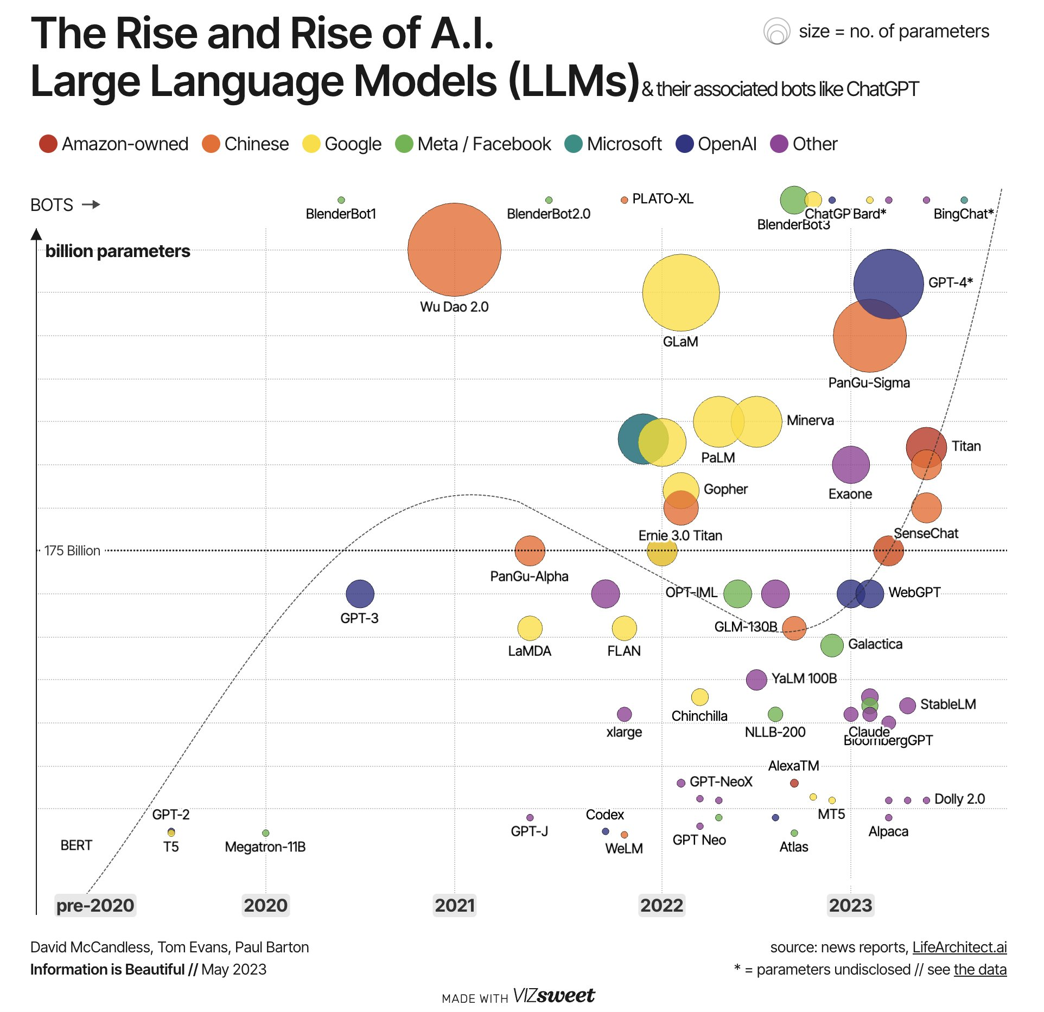
The Evolution of Large Language Models
Each increase in model size means billions more parameters to store
Modern LLMs require hundreds of GBs of GPU memory
Problem
Background
Solution
Evaluation
Summary

Slide 5
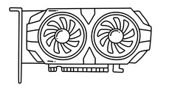
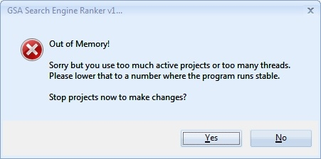
Today’s Solution
LLM’s output
Request
LLM’s outputs
Requests
Your lovely GPU just ran out of memory! Don’t panic - this presentation might help.
Problem
Background
Solution
Evaluation
Summary

Slide 6
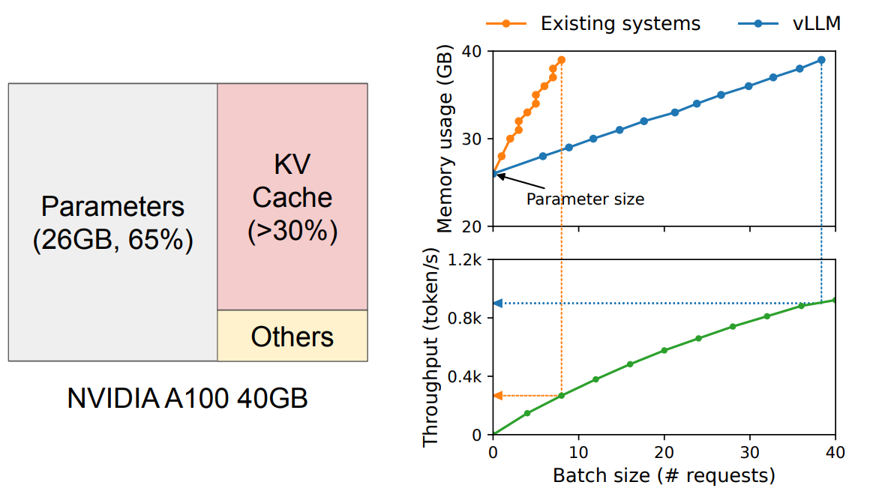
Where does the GPU Memory Go?
Dynamic part:
Allocated and Deallocated per request
Static part:
Locked for model, it never moves
Less important:
small, temporary stuff
13B-parameter LLM on an NVIDIA A100 GPU with 40GB RAM
Problem
Background
Solution
Evaluation
Summary

Slide 7
Where the GPU Memory Goes
Our “playground” in memory
The way the KV cache is managed determines the maximum batch size
Fixed Memory Region
Small batch size
“harm” throughput
Problem
Background
Solution
Evaluation
Summary

Slide 8
How Existing Systems Operate
Reserved slots for future tokens
1 Summarize this paragraph
2 Explain quantum computing
3 Fix Grammar errors
Problem
Background
Solution
Evaluation
Summary
Notes:
Each request’s KV cache is stored in one contiguous memory block.
KV caches are unpredictable
Grow and shrink dynamically
Lifetime unknown
Length unknown

Slide 9
How Existing Systems Operate
Memory used by prompt
Actual
memory
needed
Wasted memory
1 Summarize this paragraph
1 Summarize this paragraph
2 Explain quantum computing
3 Fix Grammar errors
Problem
Background
Solution
Evaluation
Summary
Notes:
Each request’s KV cache is stored in one contiguous memory block.
KV caches are unpredictable
Grow and shrink dynamically
Lifetime unknown
Length unknown

Slide 10
How Existing Systems Operate
Memory used by prompt
Actual
memory
needed
Wasted memory
External fragmentation
1 Summarize this paragraph
1 Summarize this paragraph
3 Fix Grammar errors
2 Explain quantum computing
Problem
Background
Solution
Evaluation
Summary
Notes:
Each request’s KV cache is stored in one contiguous memory block.
KV caches are unpredictable
Grow and shrink dynamically
Lifetime unknown
Length unknown

Slide 11
How Existing Systems Operate
Memory used by prompt
Actual
memory
needed
Wasted memory
External fragmentation
1 Summarize this paragraph
1 Summarize this paragraph
3 Fix Grammar errors
2 Explain quantum computing
Actual
memory
needed
Wasted memory
Problem
Background
Solution
Evaluation
Summary
Notes:
Each request’s KV cache is stored in one contiguous memory block.
KV caches are unpredictable
Grow and shrink dynamically
Lifetime unknown
Length unknown

Slide 12
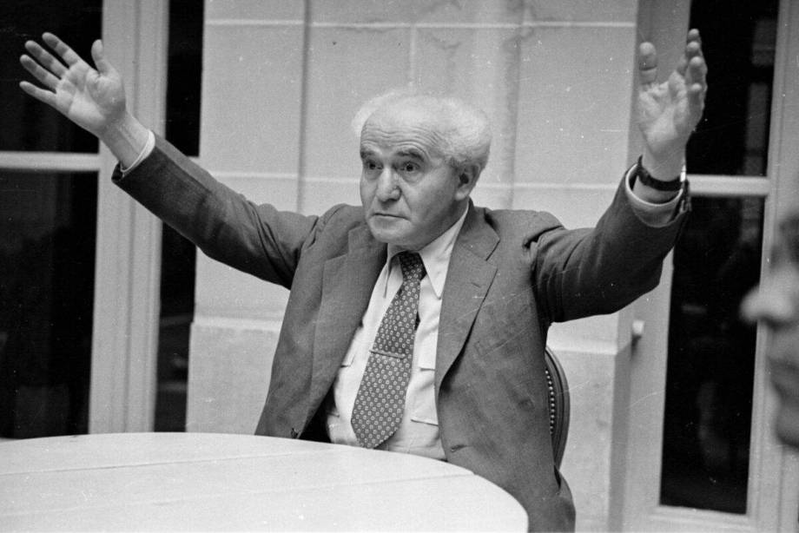
How Existing Systems Operate
1 Summarize this paragraph
1 Summarize this paragraph
3 Fix Grammar errors
2 Explain quantum computing
4 Who was David Ben-Gurion
Problem
Background
Solution
Evaluation
Summary
Notes:
Each request’s KV cache is stored in one contiguous memory block.
KV caches are unpredictable
Grow and shrink dynamically
Lifetime unknown
Length unknown
Write actual

Slide 13
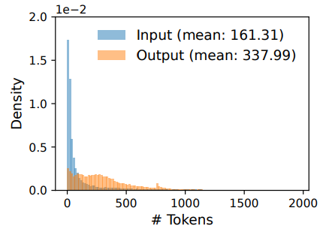
Existing Approach - Inefficient Memory Use
Typical
request
max size
Most output are short
Problem
Background
Solution
Evaluation
Summary

Slide 14
Attention
A way for a model to “look back” at previous words when generating the next one.
Query (Q) – “What am I looking for?”
Key (K) – “What do I contain?”
Value (V) – “What information should I pass on?”
Problem
Background
Solution
Evaluation
Summary

Slide 15
Attention
one
Output
Layer N
Layer 1
Input
I
have
a
dream
that
one
Problem
Background
Solution
Evaluation
Summary
Notes:
The core is an autoregressive Transformer.
It generates one token at a time using
The input (prompt)
Previous generated tokens
Repeated until the termination token.
🔄 Sequential by nature → memory-bound
underutilizes GPUs, and limits throughput.

Slide 16
Attention
day
Output
Layer N
Layer N
Layer 1
Layer 1
-0.1
0.3
1.2
0.9
0.7
0.2
-0.1
-0.3
0.1
-0.9
-0.4
0.2
Input
I
have
a
dream
that
one
Problem
Background
Solution
Evaluation
Summary
Notes:
The core is an autoregressive Transformer.
It generates one token at a time using
The input (prompt)
Previous generated tokens
Repeated until the termination token.
🔄 Sequential by nature → memory-bound
underutilizes GPUs, and limits throughput.

Slide 17
Attention
this
Output
Layer N
Layer N
Layer N
Layer 1
Layer 1
Layer 1
-0.1
0.3
1.2
0.9
0.7
0.2
-0.1
-0.3
0.1
-0.9
-0.4
0.2
1.3
-0.1
-0.6
Input
I
have
a
dream
that
one
day
Problem
Background
Solution
Evaluation
Summary
Notes:
The core is an autoregressive Transformer.
It generates one token at a time using
The input (prompt)
Previous generated tokens
Repeated until the termination token.
🔄 Sequential by nature → memory-bound
underutilizes GPUs, and limits throughput.

Slide 18





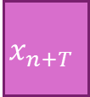










Autoregressive Generation Phase
$$x_{1}$$
$$x_{2}$$
$$…$$
$$…$$
$$…$$
$$…$$
$$x_{n}$$
$$x_{n+1}$$
$$x_{n+2}$$
$$…$$
$$…$$
$$…$$
$$…$$
$$…$$
$$…$$
$$x_{n+T}$$
LLM’s input
LLM’s output
Sequence
Each token depending on all previous ones
Key and value vectors are cached for future tokens
A token’s KV cache varies by its position in the sequence
Problem
Background
Solution
Evaluation
Summary

Slide 19
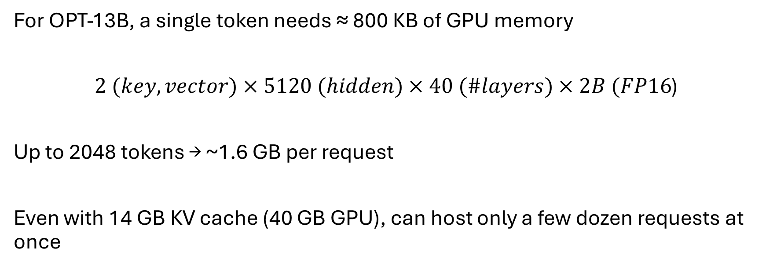
The KV Cache Problem
For OPT-13B, a single token needs ≈ 800 KB of GPU memory
$2 (key,vector)×5120 (hidden)×40 (\#layers)×2B (FP16$)
Up to 2048 tokens → ~1.6 GB per request
Even with 14 GB KV cache (40 GB GPU), can host only a few dozen requests at once
Problem
Background
Solution
Evaluation
Summary
Notes:
Because sequence lengths are unpredictable, systems pre-allocate memory for the maximum possible length.

Slide 20
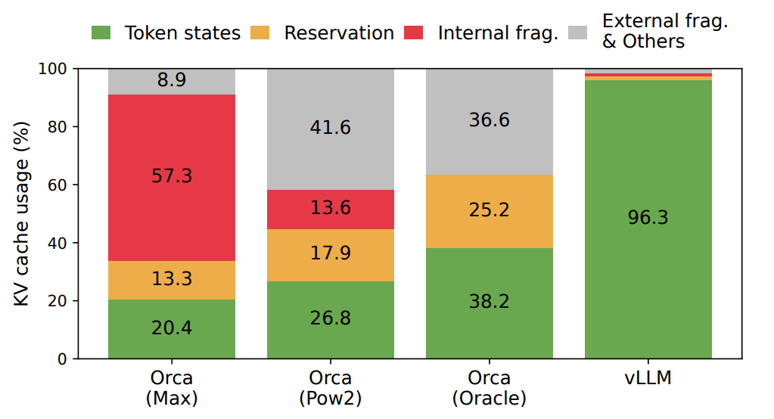
Current System Are inefficient
Only 20–38% of KV Cache Stores Token States
Problem
Background
Solution
Evaluation
Summary

Slide 21
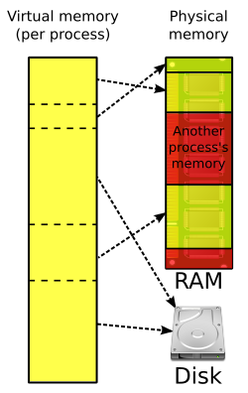
Bringing OS Concepts to LLMs
Our system adapts the idea of virtual memory for LLMs
Implements common virtual memory routines and mechanisms in software
Problem
Background
Solution
Evaluation
Summary

Slide 22
The Solution - PagedAttention
How many chickens would it take to stop a plane?
Problem
Background
Solution
Evaluation
Summary
Notes:
DO u remember VM

Slide 23
The Solution - PagedAttention
Fixed-size blocks
How
many
chickens
would
it
take
to
stop
a
plane
Problem
Background
Solution
Evaluation
Summary

Slide 24
The Solution - PagedAttention
Fixed-size blocks
Non-Contiguous Blocks
How
many
chickens
would
it
take
to
stop
a
plane
you
should
see
a
doctor
Block allocating on demand as lazy malloc | Blocks as pages
Alleviates internal fragmentation | Memory sharing like libraries
Eliminates external fragmentation | Requests as processes
Tokens as bytes
Problem
Background
Solution
Evaluation
Summary

Slide 25
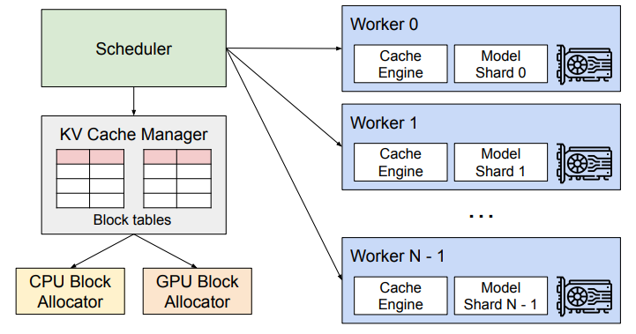
PagedAttention and the vLLM Architecture
PagedAttention and the vLLM Architecture
Introduces PagedAttention, a new attention algorithm designed for efficient KV cache management
Implements vLLM, a high-throughput LLM serving engine
Problem
Background
Solution
Evaluation
Summary

Slide 26
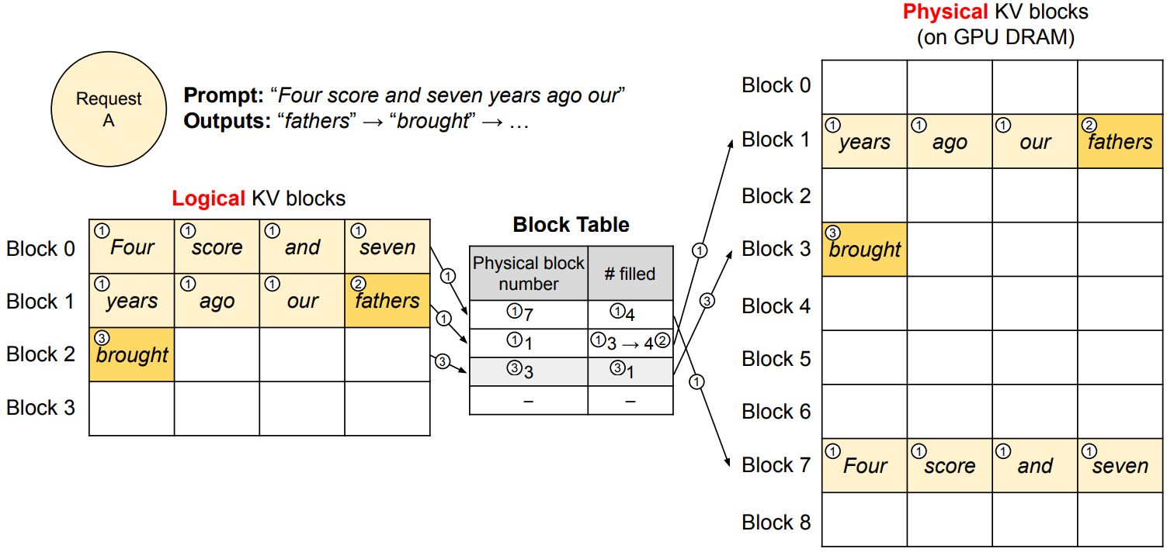
PagedAttention in Action
Problem
Background
Solution
Evaluation
Summary

Slide 27
PagedAttention in Action
Before: no preallocation
During: allocates new blocks only when full
Problem
Background
Solution
Evaluation
Summary

Slide 28
PagedAttention in Action
Before: no preallocation
During: allocates new blocks only when full
Maps logical blocks
to physical blocks
Problem
Background
Solution
Evaluation
Summary

Slide 29
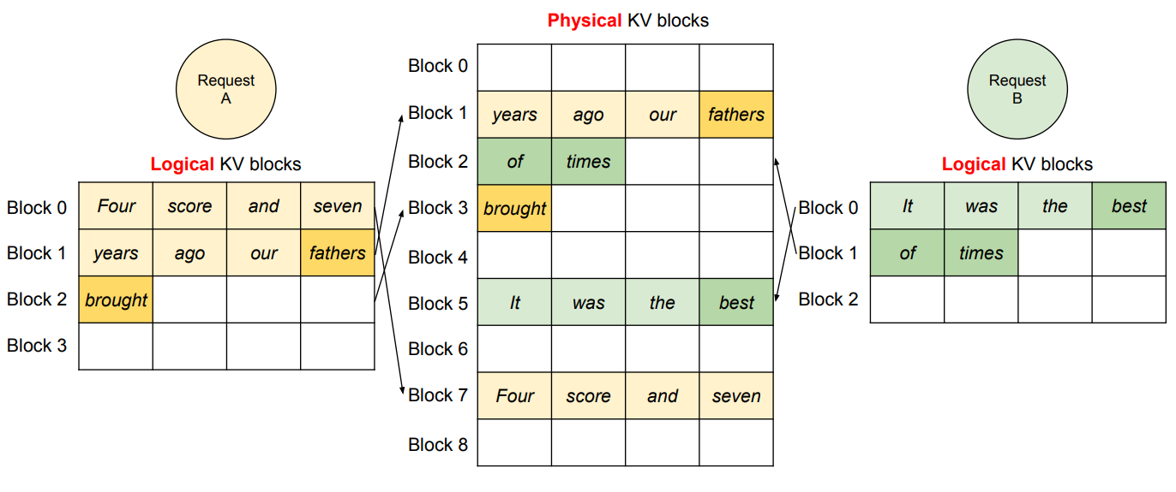
Parallel Decoding with Shared GPU Memory
Problem
Background
Solution
Evaluation
Summary

Slide 30
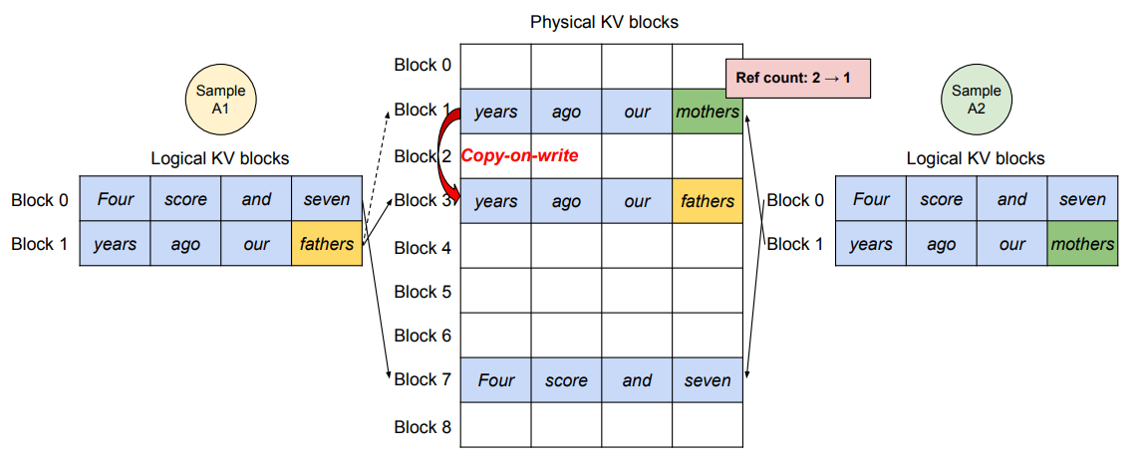
Parallel Decoding Example
Each physical block has a reference count to track shared use
Duplicated only when modified
A physical block can be shared by different sequences
Problem
Background
Solution
Evaluation
Summary

Slide 31
Beam Search Example
Copy-on-write occurs only when a shared block is modified
Block 5
Block 9
Beam candidate 0
Block 0
Block 1
Block 3
Block 6
Block 10
Beam candidate 1
Block 7
Block 11
Beam candidate 2
Block 2
Block 4
Block 8
Block 12
Beam candidate 3
Problem
Background
Solution
Evaluation
Summary

Slide 32


Shared Prefix
It’s combined with the input to form the full prompt.
Think on the shared
prefix like libc
Only the task-specific
part recomputes
Problem
Background
Solution
Evaluation
Summary

Slide 33
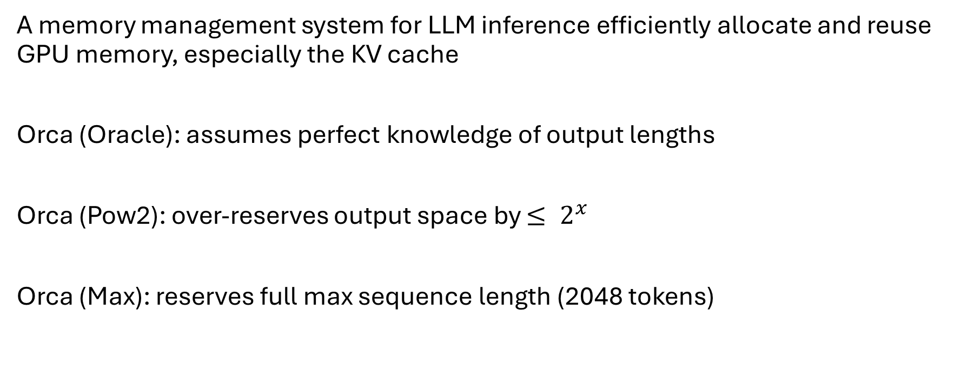
Evaluation - Orca
A memory management system for LLM inference efficiently allocate and reuse GPU memory, especially the KV cache
Orca (Oracle): assumes perfect knowledge of output lengths
Orca (Pow2): over-reserves output space by $≤ 2^{x}$
Orca (Max): reserves full max sequence length (2048 tokens)
Problem
Background
Solution
Evaluation
Summary

Slide 34
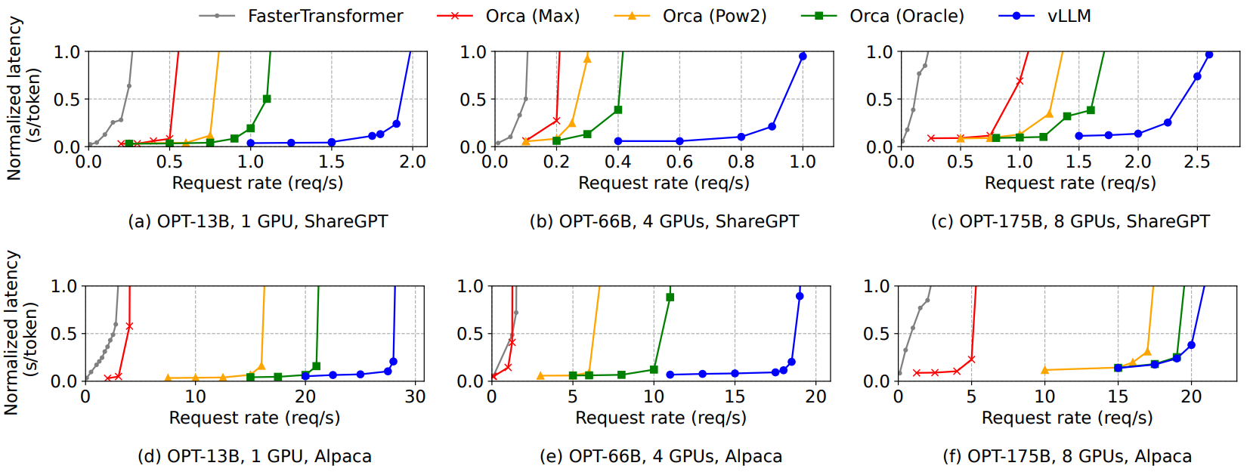


System Behavior at Scale
↑ Request rate → ↑ Latency grows … ↑ ↑ ↑ Latency grows
$$\text{2}\text{.}\text{2}\text{× }\text{higher} \text{request} \text{rates}$$
$$\text{5}\text{.}\text{4}\text{× }\text{higher} \text{request} \text{rates}$$
Orca(Max)
Orca(Pow2)
Orca(Oracle)
vLLM
Problem
Background
Solution
Evaluation
Summary

Slide 35
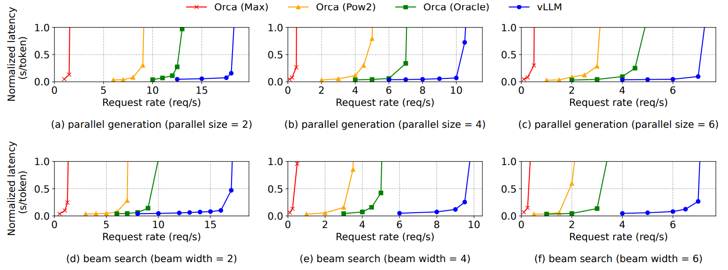
Memory Sharing Efficiency
Parallel Sampling → all sequences reuse the same KV cache
Beam Search → enables even greater KV cache sharing
Orca(Max)
Orca(Pow2)
Orca(Oracle)
vLLM
Problem
Background
Solution
Evaluation
Summary

Slide 36
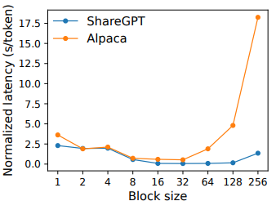
Impact of Block Size
Block size strongly affects vLLM performance
Too small → underutilized GPU parallelism
Too large → internal fragmentation and reduced sharing

Slide 37
Alpaca Dataset Results
In OPT-175B has huge GPU memory, and Alpaca’s sequences are short, making the system compute-bound
Orca(Max)
Orca(Pow2)
Orca(Oracle)
vLLM
Problem
Background
Solution
Evaluation
Summary

Slide 38
What We Covered Today
Identify the challenges in memory allocation
Propose PagedAttention, an attention algorithm that operates on KV cache, which is inspired by the virtual memory and paging in OS
Design and implement vLLM, a distributed LLM serving engine
Evaluate vLLM on various scenarios and demonstrate
Outperforms previous state-of-the-art solutions
Problem
Background
Solution
Evaluation
Summary

Slide 39
Main Takeaways
Reduces memory fragmentation with paging
Reduces memory usage with KV block sharing
Enables batching of more requests, increasing the throughput of LLM inference
vLLM achieves 2-4× throughput improvements over the state-of-the-art systems
Problem
Background
Solution
Evaluation
Summary

